Slide 1
HHRS Athletic Task Force
Facilities: Recommendations to grow and improve our athletic programs
Presented June 12, 2019
Henry Hudson Regional School

Slide 2
Committee Members
Teachers
Board Members
Atlantic Highlands
Parents
Highlands
Administrators
Coaches
Henry Hudson Regional School

Slide 3
Committee Members
Dr. Susan Compton Tri-District Superintendent
Benson Chiles Parent
Tracy Diovisalvi Parent
Vincent Esposito HHRS Dean of Student & Athletics
Claire Kozic Parent
Pat Hagan Parent
Kim Karaman HHRS Staff Member
Lenore Kingsmore HHRS Principal
Melissa Mohr BOE Member / Parent
Jay Mullan BOE Member
Janet Sherlock HHRS Staff Member – Business Administrator
Steven Stabile HHRS Staff Member
Gail Woods BOE Member (Vice President)
Henry Hudson Regional School

Slide 4
The Admiral Athletic Program Mission & Vision
Admiral Mission:
We utilize the core values of character, community and sportsmanship to teach life skills that will translate both on and off the field of play.
Our Scholar-Athletes will become pillars of our community through the lessons they learn on the field of play Admiral Vision:
We offer an inclusive interscholastic program of athletics that competes both at the Monmouth County level and State level.
We will cultivate an atmosphere where all Scholar-Athletes develop a sincere love of sport and sportsmanship
Our Scholar-Athletes will learn to be altruistic and give back to the communities of Atlantic Highlands and Highlands.
Henry Hudson Regional School

Slide 5
Our Mission…..
Pursue a vision
Review programs and facilities
Identify areas of need or improvement
Discuss ways to optimize or realize ideas
Present recommendations to the board
Henry Hudson Regional School

Slide 6
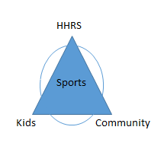
What is our goal?
How can we help our kids be competitive and excel?
How can we improve the student experience?
How can we improve the community experience?
Henry Hudson Regional School

Slide 7
Where did we start….
We started with open discussions and broad strokes
These discussions generated a lot good ideas
Henry Hudson Regional School

Slide 8
So many good ideas
And as discussions progressed……
Core areas and themes began to present themselves
Henry Hudson Regional School

Slide 9
So many good ideas
Dugouts
Multi-Purpose Field
Program Offerings
Signs
Special Events
Spectator Experience
Grounds Keeper
Kavookjian Field
Feeder Programs
Uniforms
Summer Camps
Trainer
E-Gaming
Early Development
Field Condition
Weight Room
Equipment
Intra Mural
Henry Hudson Regional School

Slide 10
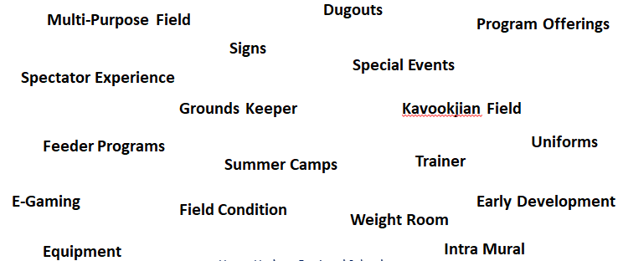
So many good ideas
Focus areas took root……
Henry Hudson Regional School

Slide 11
Focus areas stood out
Dugouts
Multi-Purpose Field
Program Offerings
Signs
Special Events
Spectator Experience
Grounds Keeper
Kavookjian Field
Feeder Programs
Uniforms
Summer Camps
Trainer
E-Gaming
Early Development
Field Condition
Weight Room
Equipment
Intra Mural
Henry Hudson Regional School

Slide 12
Key Focus Areas
Multi-Purpose Training Room (Weight Room)
Full Time Trainer
Dedicated Grounds Keeper
Turf & Current Field Facility Improvement Plan
Kavookjian Field
Formal Annual State of the Athletic Program Review & Report
Alternative Activity Program
Signage
Henry Hudson Regional School

Slide 13
Multi-Purpose Training Room
Every meeting and brainstorm around facilities improvements has identified a Weight Room as a priority item to support our athletic and physical education programs
Space and cost to build this has always been a challenge
Our discussion around this identified that a traditional “weight room” was not exactly what was needed and focus turned to providing a dedicated multi-purpose use space.
This space would support athletics, physical education and any number of other activities current and future we may want to offer (ie. Dance)
This discussion led to the identification of existing space and feasibility and logistics associated with dedicating that space began.
Henry Hudson Regional School

Slide 14
Full Time Trainer
When the topic of Athletic Trainer came up we learned ours was part time and that we were the last school in NJ without a full time trainer on staff.
Immediate consensus that if we had the means full time was a necessity
This triggered immediate discussions and action beyond the committee which led to creating a full time Athletic Trainer role
Henry Hudson Regional School

Slide 15
Grounds Keeper
Maintenance of our fields is incredibly important
Management of the facilities was falling on staff and administration whose primary focus could not always be the fields
A groundskeeper or dedicated resource is necessary to support our programs
The benefit and time value of having dedicated field maintenance oversight would be enormous. Again conversations immediately went beyond our committee and a Facilities/Maintenance Coordinator position was developed
Henry Hudson Regional School

Slide 16
Facilities Improvement Plan
A topic and project to big to be tackled through our committee
What is our best approach and option to provide the best facilities we can for our students and athletes.
Partial or Full Multi-Purpose Field: Feasibility has been at the center of discussions for some time. The topic warrants the effort of a true estimate of cost, for full or partial upper and lower fields
Improvements to Existing Fields and Facilities: Although our fields provide the basic support for our teams there are improvements that can be made to better the experience of the students (ie scoreboard, dug outs on the lower field) and the community by addressing peripheral grounds, access, seating etc.
Henry Hudson Regional School

Slide 17
Kavookjian Field
Fireman’s Field is no longer used by HHRS
New partnership developed with the Borough of Highlands to use this Kavookjian field is important going forward.
This field is in generally good shape but there are areas that can be improved (Parking, Lighting, Bleachers). We will want to support where appropriate the shared cost for maintaining and updating the facility.
Henry Hudson Regional School

Slide 18
Annual State of the Program Report
Our Athletic Programs and facilities will always require review and attention.
On an annual basis we would like to have the Dean of Students-Athletics formally report on the program highlighting successes, challenges, needs, etc. experienced throughout the year. The report should incorporate feedback from the staff, coaches and players in the on going effort for us to highlight and recognize deserving individuals and groups and understand and provide the resources required support our program.
Henry Hudson Regional School

Slide 19
Alternative Activity Program
As we talked about outside programs – Feeder programs, Travel and Club Teams, development programs and their importance intramurals came up.
Next the opportunity and importance of offering something outside an organized program evolved.
Create an outlet for kids not playing organized sports to participate and be active outside a structured sport.
Henry Hudson Regional School

Slide 20
Signage
As you walk around our grounds signage is lacking
We can use signage to help identify where you are, offer direction, and to highlight and promote HHRS.
We can possibly fund this ourselves or broaden the vision and seek sponsorships from local business or families and we can mutually benefit by supporting the school and offer exposure.
Henry Hudson Regional School

Slide 21
Reccommendations
Multi-Purpose Training Room: As the project progresses we request as much support as can be afforded to see the project through and to furnish the space with the appropriate equipment making it as functional and dynamic as possible
Full Time Trainer: Achieved
Dedicated Grounds Keeper: Achieved
Multi-Purpose Turf & Current Field Facility Improvement Plan Committee: Create a specific committee to procure and assess feasibility and estimates for a multi-purpose turf field (full, partial options with cost) and do an existing field and facility assessment, identify areas of need to provide an improvement plan (with cost). The committee will report to the board with their assessment and recommendation with next best option for review and consideration.
Kavookjian Field: Support where appropriate the shared costs that may arise with field improvements and assisting with facilitating or promoting the submission of municipal grants by the town.
Formal Annual State of the Athletic Program Review & Report: Request that the Dean of Student-Athletics deliver a formal review and assessment at a Board of Education Meeting annually to cover the state of the athletic program.
Alternative Activity Program: Create an after school activity program offering an outlet for kids not on a team to participate in intramural sports or activities.
Signage Committee: Create an ad hoc committee to assess the grounds and develop a signage plan to help identify type and placement for best effect, identify cost and funding options or alternatives.
Henry Hudson Regional School

Slide 22
Henry Hudson Regional School

